Slide 1
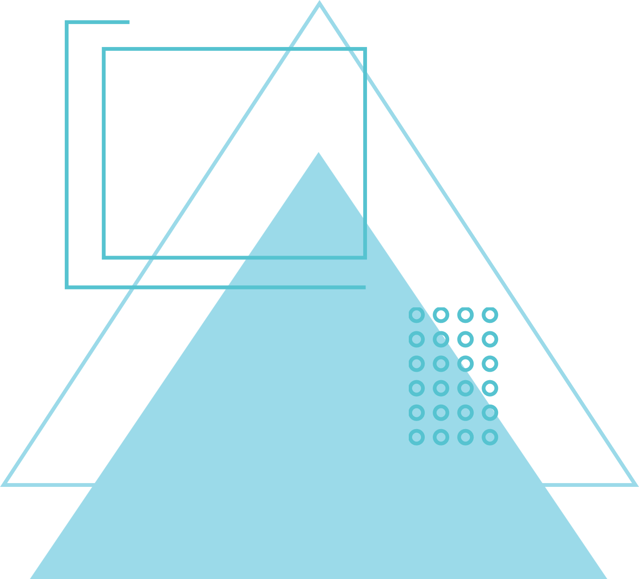

KIET GROUP OF INSTITUTIONS
Minor Project Presentation on
PATHFINDER PRO
Group Members -
Shubham Tiwari (2300290140179)
Shivank Naruka (2300290140174)
Utkarsh Kumar Singh (2300290140198)
Project Guide
Mr. Ritesh Kumar Gupta

Slide 2
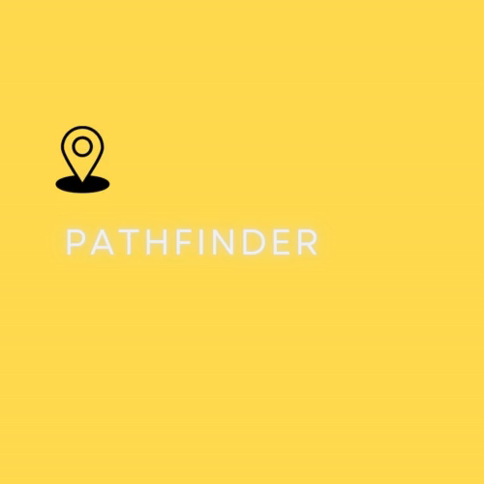

Slide 3



OUTLINE
Introduction
Literature Review
Objective
Requirements
Modules
Workflow
References

Slide 4

INTRODUCTION
The Virtual BFS and Dijkstra Algorithm Analyzer is an interactive web console application designed to visualize and analyze the Breadth-First Search (BFS) and Dijkstra's algorithms. By providing a platform for users to explore graph traversal and shortest path finding techniques, this project aims to enhance understanding of these fundamental algorithms in computer science.

Slide 5
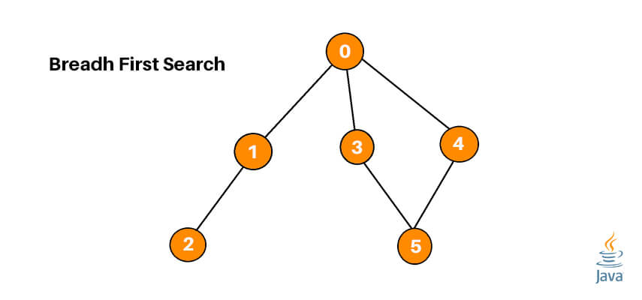
Breadth First Search
Initialize a Queue: Start with a queue to keep track of the nodes to be explored.
Mark Visited Nodes: Maintain a list or set of visited nodes to avoid cycles.
Enqueue the Start Node: Add the starting node to the queue and mark it as visited.
Process Nodes: While the queue is not empty:
Dequeue a node.
Process it (e.g., print it, or add it to the result).
Enqueue all its unvisited neighbors, marking them as visited.
Continue Until Done: Repeat until all reachable nodes are visited.

Slide 6
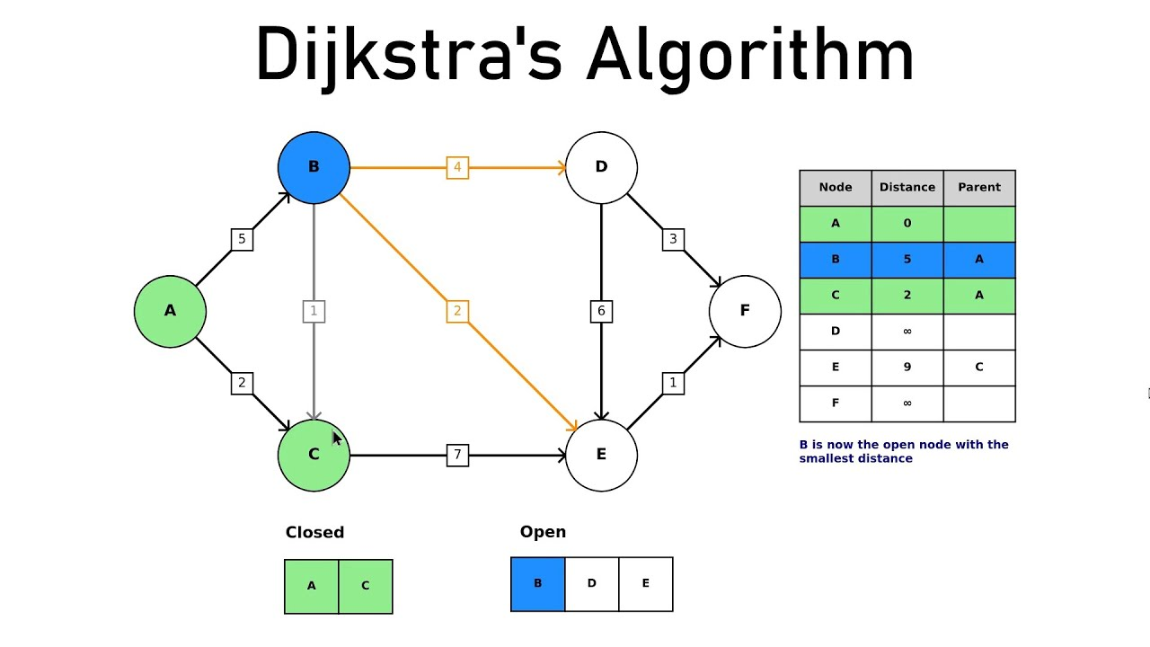
Dijkstra Algorithm
Initialize Distances: Set the distance to the starting node to zero and all other nodes to infinity.
Create a Priority Queue: Use a priority queue to select the node with the smallest distance.
Process Nodes: While there are nodes in the queue:
Dequeue the node with the smallest distance.
Update the distances to its neighbors.
If a shorter path to a neighbor is found, update its distance and add it back to the queue.
Terminate: When the queue is empty, the shortest paths to all reachable nodes are finalized.

Slide 7

LITERATURE SURVEY
Sno | Year | Author | Contribution
1 | 2024 [1] | Yu Tang and Xintian Liu | It demonstrated that BFS is faster but less optimal, while Dijkstra’s algorithm is more reliable but leads to longer paths in smart parking systems.
2 | 2023[2] | Yiquan Du | Dijkstra's algorithm was combined with reinforcement learning for autonomous vessel path planning, enhancing real-time decision-making and adaptive, safer navigation in dynamic environments.
3 | 2020 [3] | Tim Roughgarden | Roughgarden's work on algorithmic design explored the evolution of pathfinding algorithms like BFS and Dijkstra, emphasizing their influence on computational complexity and real-world applications in navigation and network routing.

Slide 8

OBJECTIVE
Educational Tool
Comparison of Algorithms
Interactive User Experience
Real-World Application
Testing Algorithm
Customizability

Slide 9
REQUIREMENTS
HARDWARE
SOFTWARE
HTML
CSS
JavaScript
Python and its libraries
Flask
OS : Windows 10
Installed RAM : 4 GB
Processor : intel i3 or above
System type : 64 bit OS

Slide 10
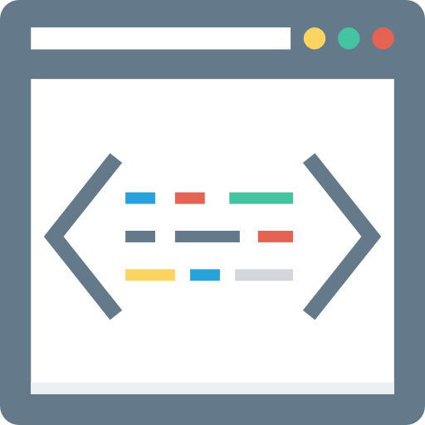

Modules
Frontend and UI
User can interact through dynamic webpages
They can select the algorithm using a dropdown menu
Implementation of Algorithms
Algorithms (Dijkstra and BFS) are coded in IDE
Visually represented through console

Slide 11

Modules
Integration Module
The website and the console application will be integrated through flask
User can directly access the pycharm console through the website

Slide 12
Project Flow
User Interface
Buttons for selecting the algorithm (Dijkstra/BFS) and starting the visualization
Dijkstra's Algorithm
visualization for keeping track of the next node to explore.
BFS Algorithm
Visualization of node exploration level by level (breadth-first).
Visualization Techniques
Use animations to demonstrate the process step by step

Slide 13
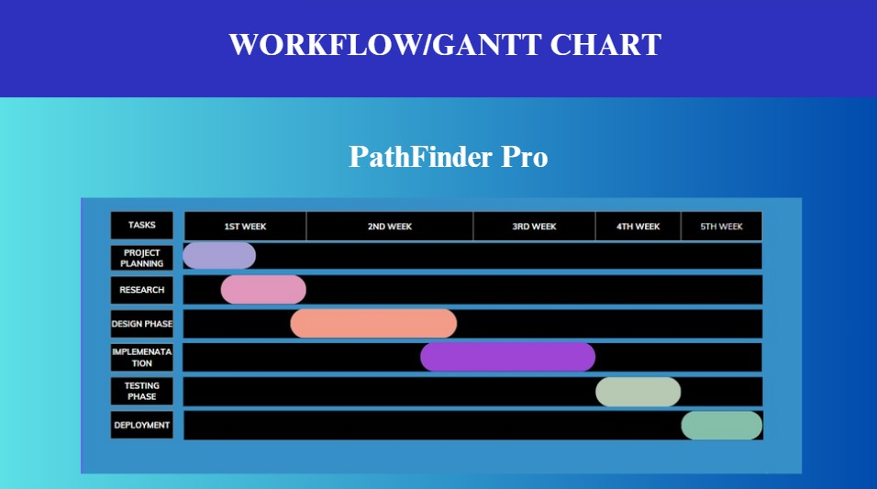
Gantt Chart

Slide 14
EXPECTED OUTCOME
Outcomes of the project
Quality Education
Real-life usage
Improved Skills
Improved Understanding
Visualization of complex concepts

Slide 15
CONCLUSION
In conclusion, the Pathfinding Visualizer project helps users see how Dijkstra’s and BFS algorithms work through simple, interactive visuals. By letting users create their own graphs, it offers a fun and easy way to understand these algorithms. The project shows how each algorithm performs, making it clear where they are strong or weak. It works as both a learning tool and a way to compare pathfinding methods.

Slide 16
REFERENCES
Books
Cormen, Thomas H., Charles E. Leiserson, Ronald L. Rivest, and Clifford Stein. Introduction to Algorithms. 3rd ed. Cambridge: MIT Press, 2009. Sedgewick, Robert, and Kevin Wayne. Algorithms. 4th ed. Boston: Addison-Wesley, 2011.
Research Papers
Dijkstra, Edsger W. “A Note on Two Problems in Connection with Graphs.” Numerische Mathematik 1 (1959): 269–271. Moore, Edward F. “The Shortest Path through a Network.” Operations Research 5, no. 2 (1957): 171–178.
Online Resources
GeeksforGeeks. “Graph Data Structure and Algorithms.” Accessed September 20, 2024. [https://www.geeksforgeeks.org/graph-data-structure-and-algorithms/](https://www.geeksforgeeks.org/graph-data-structure-and-algorithms/)

Slide 17
THANK YOU

